Slide 1
Wavepackets
Outline
Review: Reflection & Refraction
Superposition of Plane Waves
- Wavepackets
Δk – Δx Relations

Slide 2
Sample Midterm 2
(one of these would be Student X’s Problem)
Q1: Midterm 1 re-mix
(Ex: actuators with dielectrics)
Q2: Lorentz oscillator
(absorption / reflection / dielectric constant /
index of refraction / phase velocity)
Q3: EM Waves
(Wavevectors / Poynting / Polarization /
Malus' Law / Birefringence /LCDs)
Q4: Reflection & Refraction
(Snell's Law, Brewster angle, Fresnel Equations)
Q5: Interference / Diffraction

Slide 3
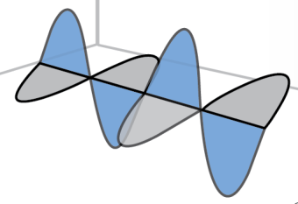
Electromagnetic Plane Waves
The Wave Equation

Slide 4
Reflection of EM Waves at Boundaries
incident wave
Write traveling wave terms in each region
Determine boundary condition
transmitted
wave
reflected
wave
Infer relationship of ω_{1,2} & k_{1,2}
Solve for E_{ro} (r) and E_{to} (t)
Medium 1
Medium 2

Slide 5
Reflection of EM Waves at Boundaries
incident wave
Write traveling wave terms in each region
transmitted
wave
reflected
wave
Determine boundary condition
Infer relationship of ω_{1,2} & k_{1,2}
Solve for E_{ro} (r) and E_{to} (t)
Medium 1
Medium 2
At normal incidence..

Slide 6
Oblique Incidence at Dielectric Interface
E-field
polarization perpendicular to the plane of
incidence (TE)
Write traveling wave terms in each region
Determine boundary condition
Infer relationship of ω_{1,2} & k_{1,2}
Solve for E_{ro} (r) and E_{to} (t)
E-field polarization parallel to
the plane of incidence (TM)
•

Slide 7
Oblique Incidence at Dielectric Interface
Write traveling wave terms in each region
Determine boundary condition
Infer relationship of ω_{1,2} & k_{1,2}
Solve for E_{ro} (r) and E_{to} (t)
•

Slide 8
Oblique Incidence at Dielectric Interface
Write traveling wave terms in each region
Determine boundary condition
Infer relationship of ω_{1,2} & k_{1,2}
Solve for E_{ro} (r) and E_{to} (t)
•
Tangential field is continuous (z=0)..

Slide 9
Snell’s Law
Tangential E-field is continuous …
REMINDER:
•

Slide 10
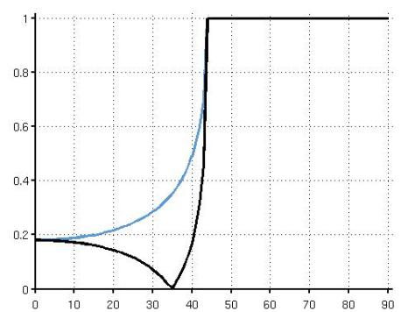
Reflection of Light
(Optics Viewpoint … μ₁ = μ₂)
TE:
TM:
E-field perpendicular to the plane of incidence
TE
Reflection Coefficients
E-field parallel to the plane of incidence
TM
•
Incidence Angle

Slide 11
Electromagnetic Plane Waves
The Wave Equation
When did this plane wave turn on?
Where is there no plane wave?

Slide 12
Superposition Example: Reflection
incident wave
transmitted wave
reflected wave
Medium 1
Medium 2
How do we get a wavepacket (localized EM waves) ?

Slide 13
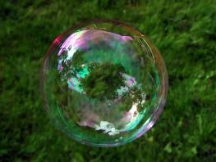
Superposition Example: Interference
Reflected Light Pathways Through Soap Bubbles
Constructive Interference
(Wavefronts in Step)
Destructive Interference
(Wavefronts out of Step)
Incident
Light
Path
Reflected
Light
Paths
Incident
Light
Path
Reflected
Light
Paths
Outer Surface
of Bubble
Image by Ali T http://www.flickr
.com/photos/77682540@N00/27
89338547/ on Flickr.
Thin Part of Bubble
Thick Part of Bubble
Inner Surface
of Bubble
What if the interfering waves do not have the same frequency (ω, k) ?

Slide 14
Two waves at different frequencies
… will constructively interfere and destructively interfere at different times
In Figure above the waves are chosen to have a 10% frequency difference. So when the slower wave goes through 5 full cycles (and is positive again), the faster wave goes through 5.5 cycles (and is negative).

Slide 15
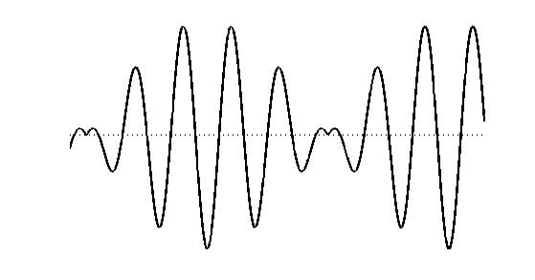

Wavepackets: Superpositions Along Travel Direction
REMINDER:
SUPERPOSITION OF TWO WAVES OF DIFFERENT FREQUENCIES
(hence different k’s)

Slide 16
Wavepackets: Superpositions Along Travel Direction
WHAT WOULD WE GET IF WE SUPERIMPOSED
WAVES OF MANY DIFFERENT FREQUENCIES ?
LET’S SET THE FREQUENCY DISTRIBUTION as GAUSSIAN
REMINDER:

Slide 17
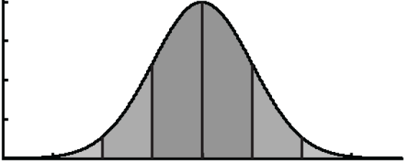
Reminder: Gaussian Distribution
50% of data within
μ specifies the position of the bell curve’s central peak
σ specifies the half-distance between inflection points
FOURIER TRANSFORM OF A GAUSSIAN IS A GAUSSIAN

Slide 18
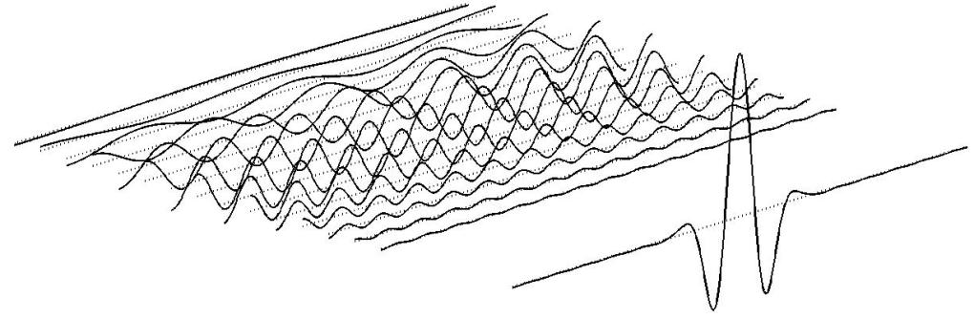

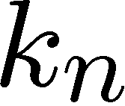
Gaussian Wavepacket in Space
SINUSOIDS TO BE SUPERIMPOSED
SUM OF SINUSOIDS
= WAVEPACKET
WE SET THE FREQUENCY DISTRIBUTION as GAUSSIAN

Slide 19
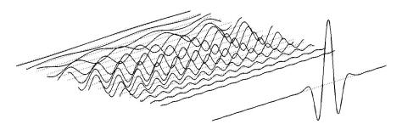

Gaussian Wavepacket in Time
GAUSSIAN ENVELOPE

Slide 20
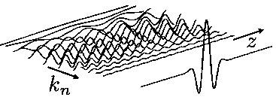
Gaussian Wavepacket in Space
WAVE PACKET
GAUSSIAN ENVELOPE
In free space …
… this plot then shows the PROBABILITY OF
WHICH k (or frequency) EM WAVES are
MOST LIKELY TO BE IN THE WAVEPACKET

Slide 21
Gaussian Wavepacket in Time
WAVE PACKET
UNCERTAINTY
RELATIONS
If you want to LOCATE THE WAVEPACKET WITHIN THE SPACE Δz
you need to use a set of EM-WAVES THAT SPAN THE WAVENUMBER SPACE OF Δk = 1/(2Δz)

Slide 22
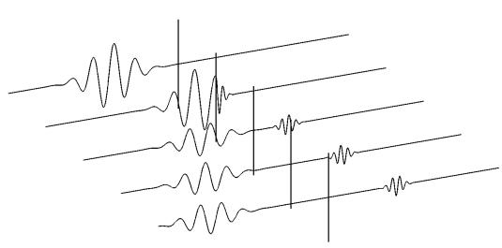
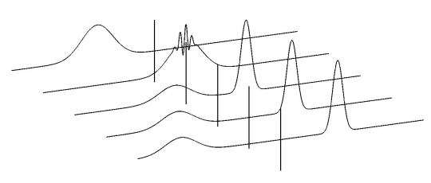


Wavepacket Reflection

Slide 23
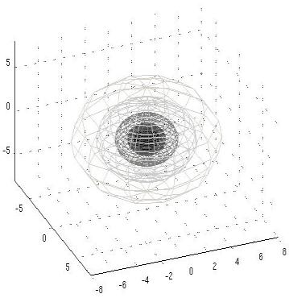
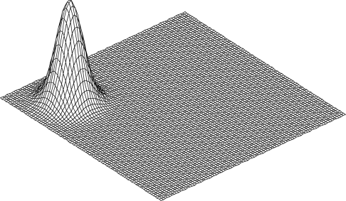


Wavepackets in 2-D and 3-D
Contours of constant amplitude
2-D
3-D
Spherical probability distribution
for the magnitude of the amplitudes
of the waves in the wave packet.

Slide 24
In the next few lectures we will start considering the limits of
Light Microscopes
and how these might affect our understanding of the world we live in
incident
photon
electron
Suppose the positions and speeds of all particles in
the universe are measured to sufficient accuracy at a particular instant in time
It is possible to predict the motions of every particle at any time in the future (or in the past for that matter)

Slide 25
Key Takeaways
WAVE PACKET
GAUSSIAN WAVEPACKET IN SPACE
GAUSSIAN ENVELOPE
UNCERTAINTY
RELATIONS

Slide 26
MIT OpenCourseWare
http://ocw.mit.edu
6.007 Electromagnetic Energy: From Motors to Lasers
Spring 2011
For information about citing these materials or our Terms of Use, visit: http://ocw.mit.edu/terms.

