Slide 1
Electromagnetic Waves
Reading – Shen and Kong – Ch. 3
Outline
Review of the Quasi-static Approximation
Electric and Magnetic Components of Waves
The Wave Equation (in 1-D)
Uniform Plane Waves
Phase Velocity and Intrinsic Impedance
Wave-vector and Wave-frequency

Slide 2
Maxwell’s Equations (Free Space with Charges)
Differential form
Integral form
E-Gauss:
Faraday:
H-Gauss:
Ampere:
In statics, both time derivatives are unimportant, Maxwell’s Equations split into decoupled electrostatic and magnetostatic equations.
In Electro-quasistatic (EQS) and magneto-quasitatic systems (MQS), one (but not both) time derivative becomes important.

Slide 3








Quasi-static Maxwell’s Equations
Electric Fields
Magnetic Fields
EQS
MQS
For the error in the
QS approximation to be small …
or
Notes:
Why are EQS and MQS written here even though there are no time derivatives?

Slide 4



EQS vs MQS for Time-Varying Fields
Why did we not worry about the magnetic field generated
by the time-varying electric field of a motor ?
animate
A typical motor frequency of 2000 rpm satisfies
EQS approximation for free-space
As another example, note:
At 60 Hz, the wavelength (typical length) in air is 5000 km, therefore, almost all physical 60-Hz systems in air are quasistatic (since they are typically smaller than 5000 km in size)

Slide 5
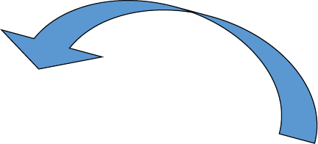




Coupling of Electric and Magnetic Fields
Maxwell’s Equations couple the E and H fields:
animate

Slide 6





Uniform Electromagnetic Waves
E_{y} varies along the z-direction and E is
constant in the two other directions

Slide 7


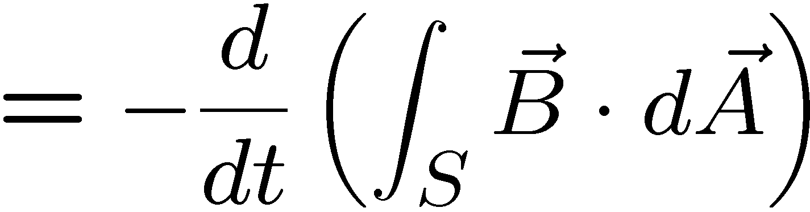

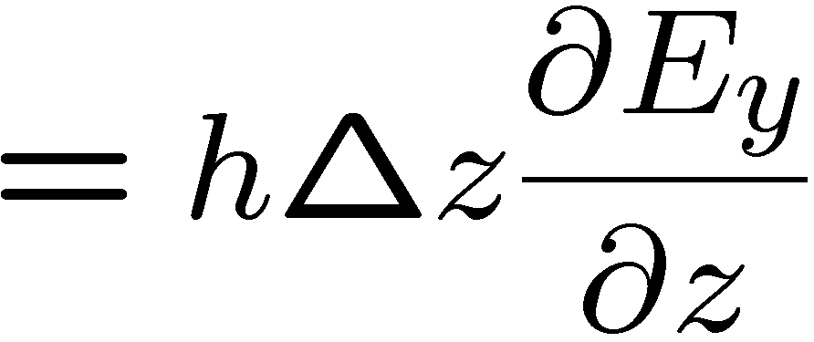
Uniform Electromagnetic Waves
E_{y} varies along the z-direction and E_{y} is
constant in the other two directions
animate

Slide 8
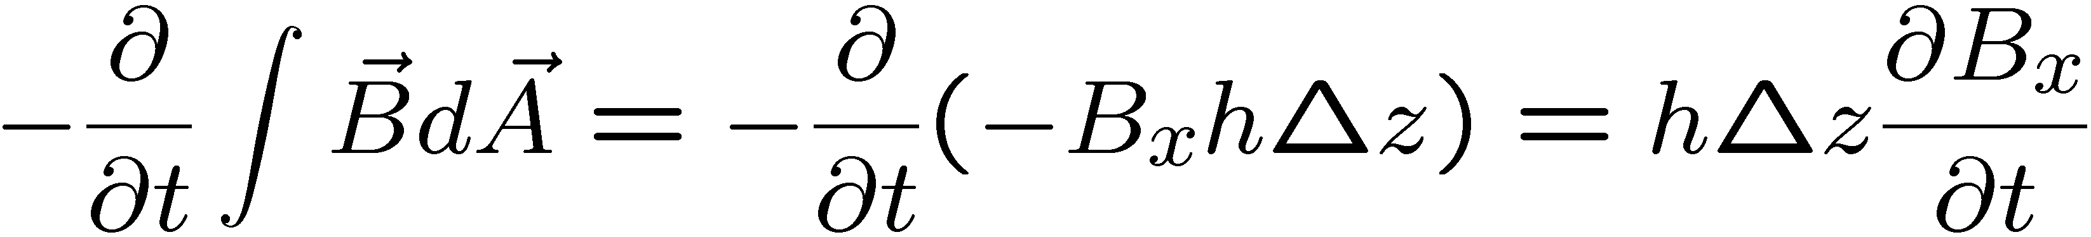
Electromagnetic Waves
E_{y}-field cannot vary in z-direction without a time-varying B-field …
…and waves must have both electric and magnetic components !

Slide 9

Uniform Electromagnetic Plane Waves
The y-component of E that varies across space is associated with
the x-component of B that varies in time

Slide 10



Uniform Electromagnetic Plane Waves
Source free:

Slide 11



The Wave Equation
Time-varying E_{y} generates spatially varying B_{z} …
Time-varying B_{z} generates spatially varying E_{y} …
The temporal and spatial variations in E_{y} are coupled together to yield …
… the Wave Equation.

Slide 12
The Wave Equation via Differential Equations
Faraday:
Ampere:
Substitution yields the wave equation:

Slide 13

Uniform Plane Wave Solutions
The 1-D wave equation
E_{y}(z,t) is any function for which the second derivative in space equals its second derivative in time, times a constant. The solution is therefore any function with the same dependence on time as on space, e.g.
The functions f₊(z-ct) and f₋ (z+ct) represent uniform waves propagating in the +z and -z directions respectively.

Slide 14

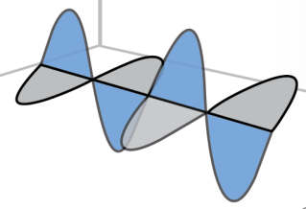
Speed of Light
The velocity of propagation is determined solely by the dielectric permittivity and magnetic permeability:
The functions f₊ and f₋ are determined by the source and the other boundary conditions.
animate

Slide 15

Magnetic Field of a Uniform Plane Wave
In vacuum…

Slide 16



A Uniform Plane Wave
Inside a material…
… where
is known as the phase velocity
of the wave

Slide 17


The Characteristic Impedance
η is the intrinsic impedance of the medium given by
Like the velocity of propagation, the intrinsic impedance is independent of the source and is determined only by the properties of the medium.

Slide 18



Sinusoidal Uniform Plane Waves
… where
… is known
as the
wave-number

Slide 19

Sinusoidal Uniform Plane Waves

Slide 20



Sinusoidal Uniform Plane Waves
Spatial quantities:
Temporal quantities:

Slide 21
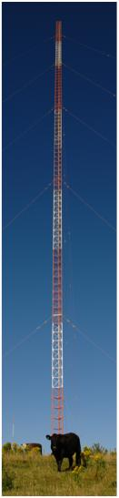
How Are Uniform EM Plane Waves Launched?
Generally speaking, electromagnetic waves are launched
by time-varying charge distributions and currents,
that together must satisfy:
Man-made systems that launch waves are often called antennas.
Uniform plane waves are launched by current sheets: .
K
Image is in the public domain.

Slide 22
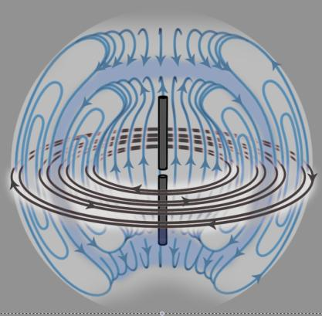
Dipole Antenna
Quarter wavelength vertical antenna has one connection to the vertical element and uses earth connection to provide an image for the other quarter wave. The voltage and current waveforms are out of phase.
The antenna generates (or receives) the omni-directional radiation pattern in the horizontal plane. The antenna does not have to be re-orientated to keep the signals constant as, for example, a car moves its position.
Voltage
Quarter wave
veritcal
antenna
Electric fields (blue) and magnetic fields (gray) radiated by a dipole antenna
Current
Coaxial
Cable
feeder
Connection to earth

Slide 23
KEY TAKEAWAYS
Time-varying E_{y} generates spatially varying B_{z}
Time-varying B_{z} generates spatially varying E_{y}
The1-D Wave Equation
has solutions of the form
… with propagation velocity:
(speed of light)
… and more generally:
(phase velocity)
… where
… is known as the
intrinsic impedance
… is known as the
wave-number

Slide 24
MIT OpenCourseWare
http://ocw.mit.edu
6.007 Electromagnetic Energy: From Motors to Lasers
Spring 2011
For information about citing these materials or our Terms of Use, visit: http://ocw.mit.edu/terms.

