Slide 1
Limits to Statics and Quasistatics
Reading – Haus and Melcher - Ch. 3
Outline
Limits to Statics
Quasistatics
Limits to Quasistatics

Slide 2

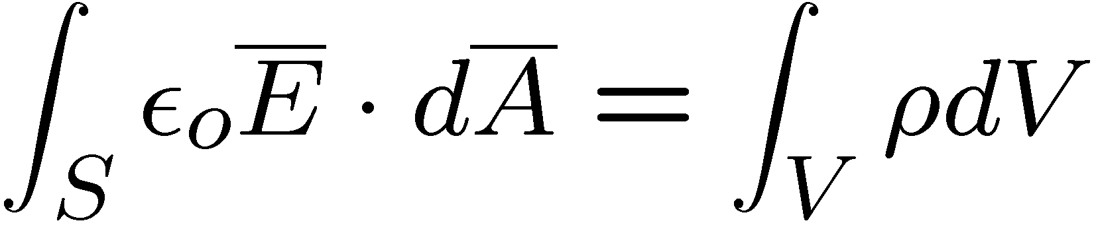


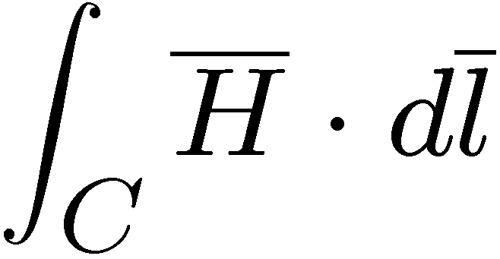
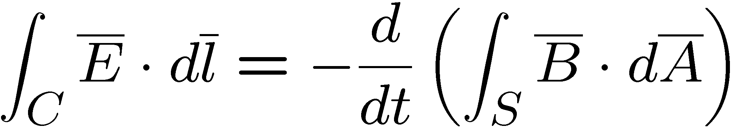
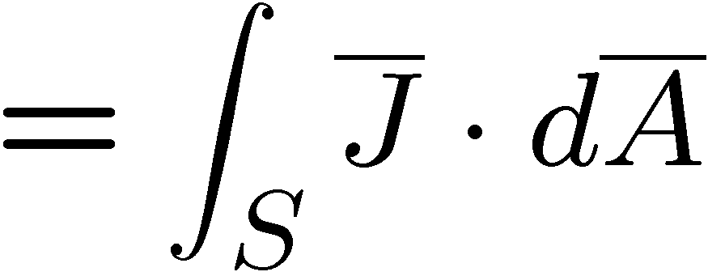
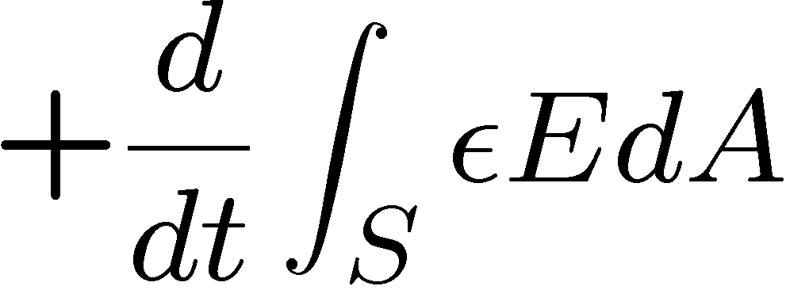
Electric Fields
Magnetic Fields
GAUSS
GAUSS
FARADAY
AMPERE
For Statics systems both time derivatives are unimportant, and Maxwell’s Equations split into decoupled electrostatic and magnetostatic equations.
Electro-quasistatic and Magneto-quasitatic systems arise when one
(but not both) time derivative becomes important.

Slide 3
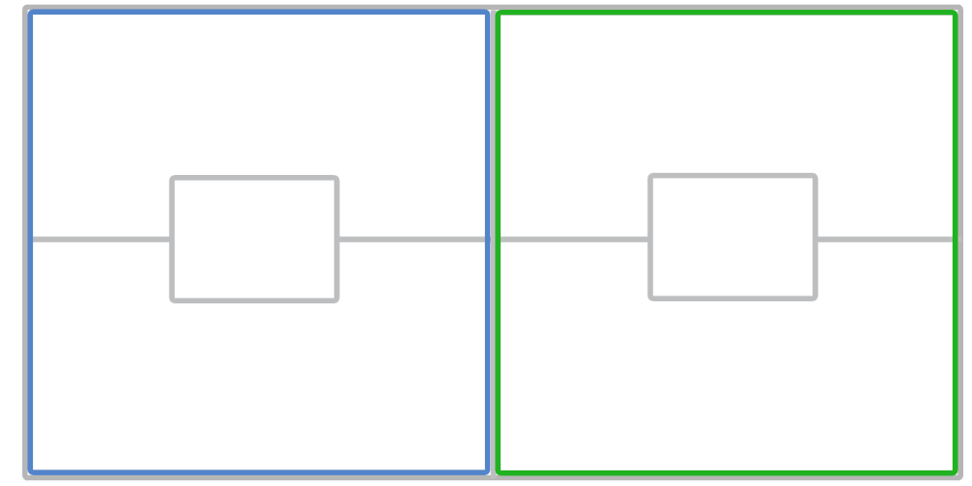
Quasi-static Maxwell’s Equations
Electric Fields
Magnetic Fields
EQS
MQS

Slide 4
Coupling of Electric and Magnetic Fields
Maxwell’s Equations couple H and E fields ...
When can we neglect this coupling ?
Why do we predominantly think about E-fields for capacitors ?
H-fields for inductors ?

Slide 5
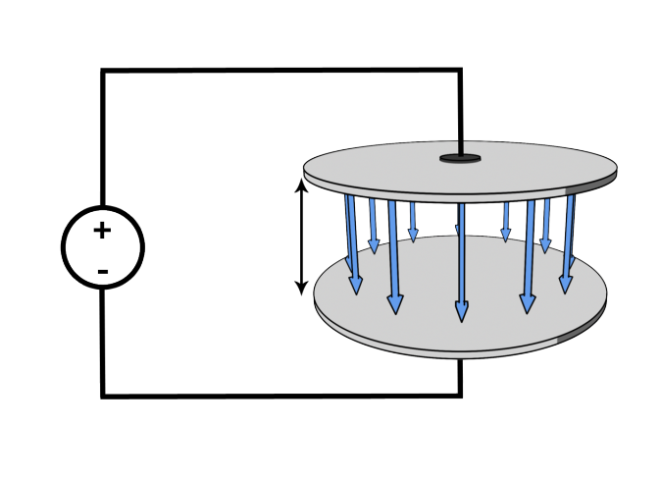
“Statics” Treatment of a Capacitor
E
The electric field at one time depends only on the voltage at that time
Is there a magnetic field within the capacitor?

Slide 6
Sinusoidal Steady-State Analysis
WE WILL INTRODUCE THIS MATHEMATICAL TOOL TO HELP US ANALYZE SINUSOIDALLY CHANGING FIELDS
For the general variable
assume
so that
Drop and for simplicity
so that and

Slide 7
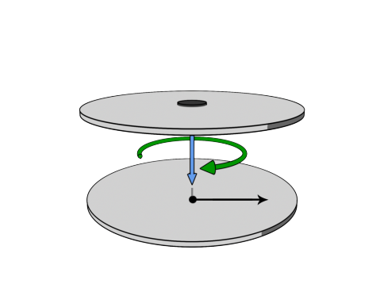
Magnetic Field inside the Capacitor
Assume SSS analysis:
H
E
Ampere:
Let the contour C follow H_{Ф}
and use symmetry
If the E-field in the capacitor is changing, it will induce the circular H-field

Slide 8
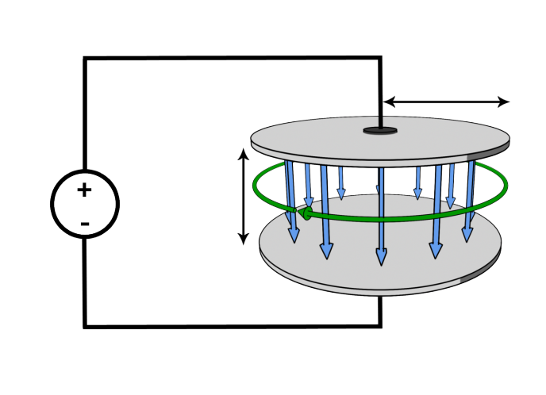
Is the electric field spatially constant within the capacitor?
H
E
Faraday:
The induced circular H-field will then induce an additional E-field

Slide 9
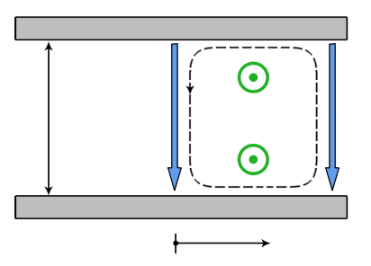
Corrected Electric Field inside the Capacitor
Faraday:
E
E
H
The induced E-field will “fight” the initial E-field

Slide 10
When is the electric field correction small?
Small correction
Outer radius
…Small device
… inconsequential magnetic energy storage.

Slide 11
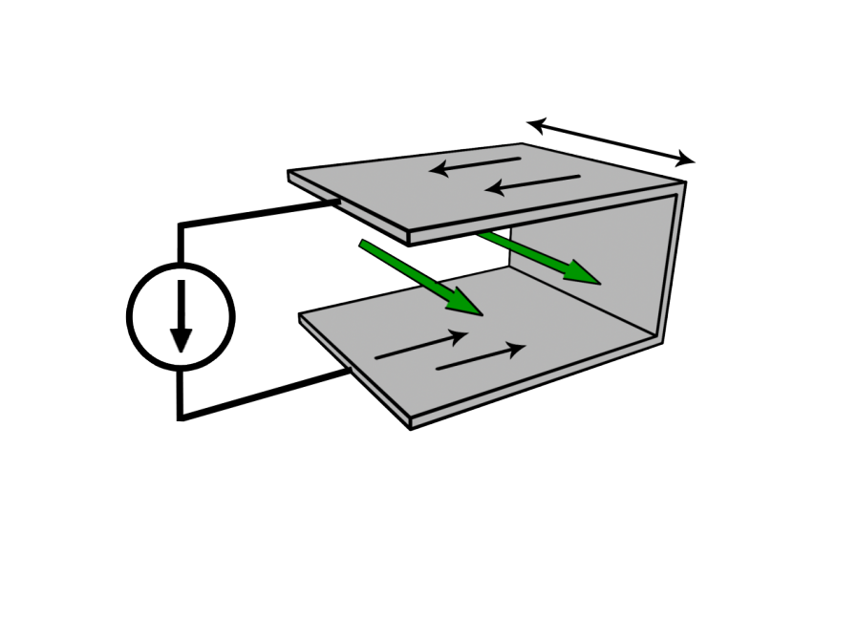
“Statics” Treatment of an Inductor
H
The magnetic field at one time depends only on the current at that time

Slide 12
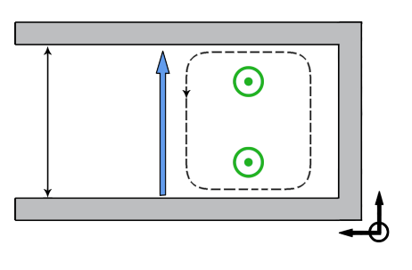
Electric Field Inside the Inductor
H
E
H
&
If the H-field in the inductor is changing, it will induce an E-field

Slide 13
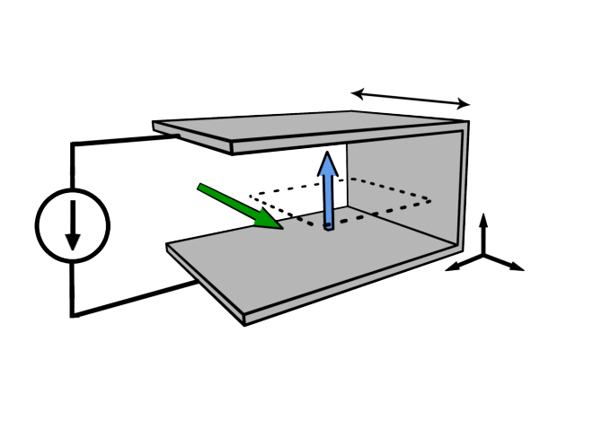
Corrected Magnetic Field inside the Inductor
Ampere:
H
E
The induced E-field will then induce an additional H-field
(that will “fight” the initial H-field)

Slide 14
When is the magnetic field correction small?
Small correction
length
…Small device
… Inconsequential electric energy storage

Slide 15
Which Device is “Static”?
Power line from Boston to Chicago operating at 60 Hz
The length of the power line is approximately 1500 km.
The wavelength of light at 60 Hz is approximately 5000 km.
Pentium MOSFET operating at 3 GHz … ignoring any conductivity
The width of a transistor is approximately 100 nm
The wavelength of light at 3 GHz is approximately 0.1 m.
This device is a static device.

Slide 16
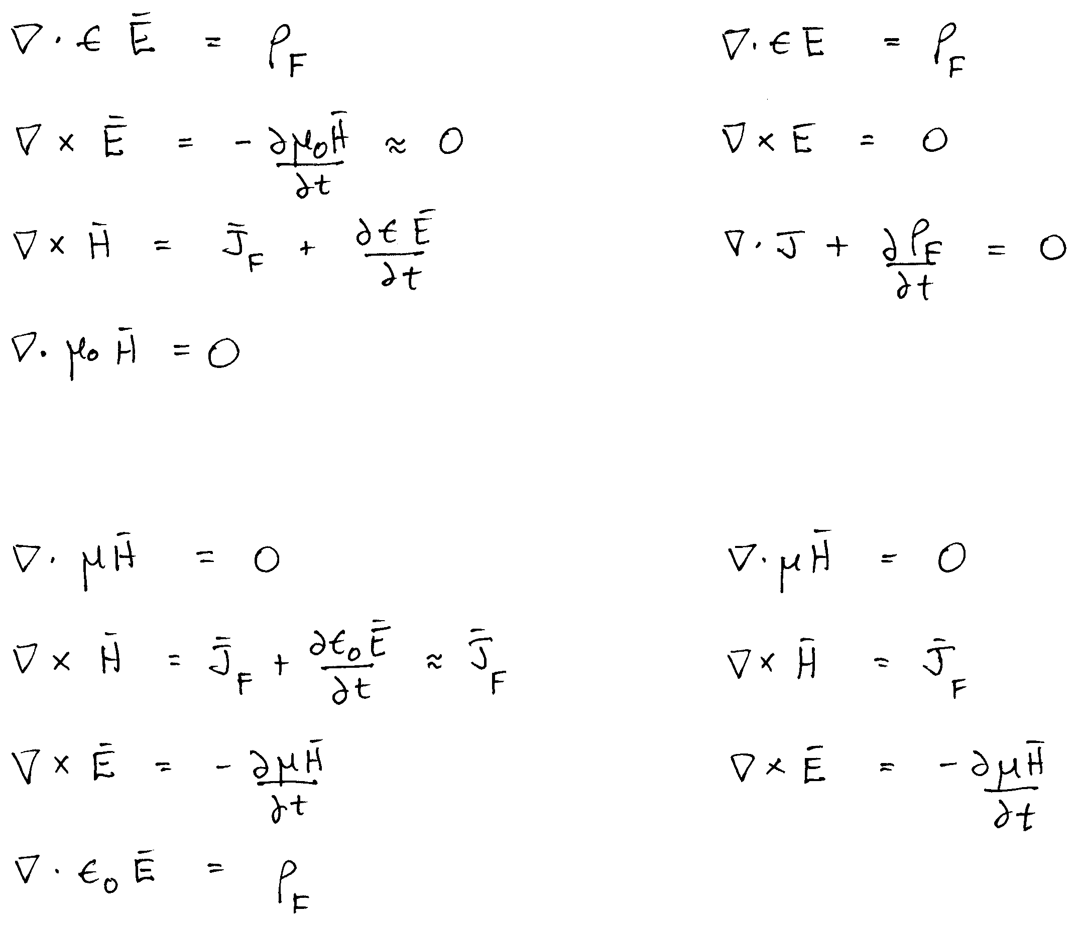
Quasistatics … One Time Derivative is Small
SMALL
Electro-quasistatic
(EQS)
SMALL
Magneto-quasitatic
(MQS)

Slide 17

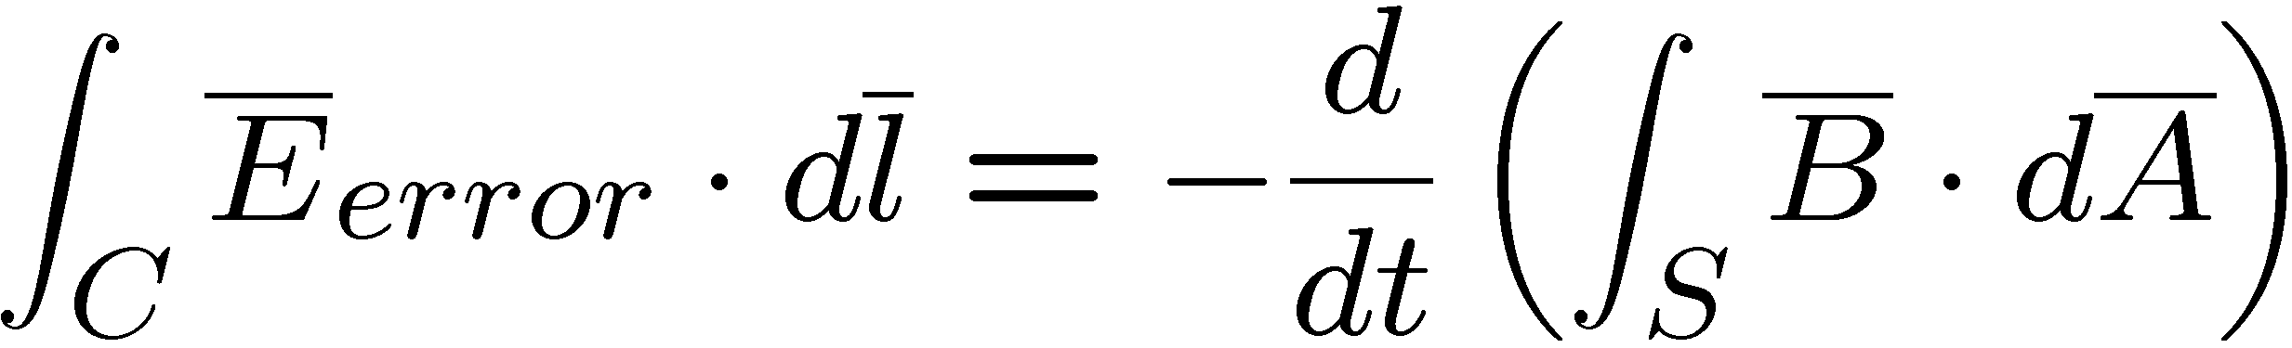

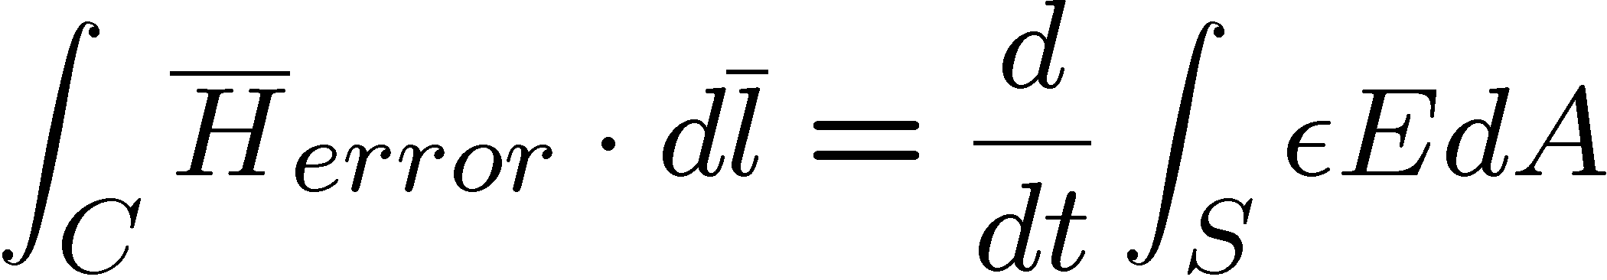
Summary: Error in Using the Quasi-static Approximation
Fields are the approximate field from the quasistatic approximation
plus the induced fields that have been neglected …
where
where
How do we know when the errors (induced fields) are small relative to the QS fields ?

Slide 18
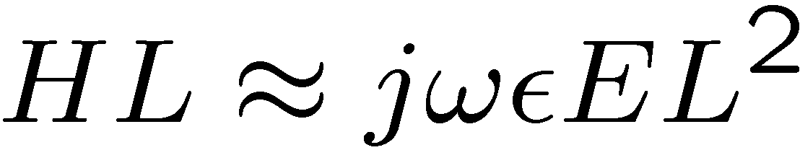
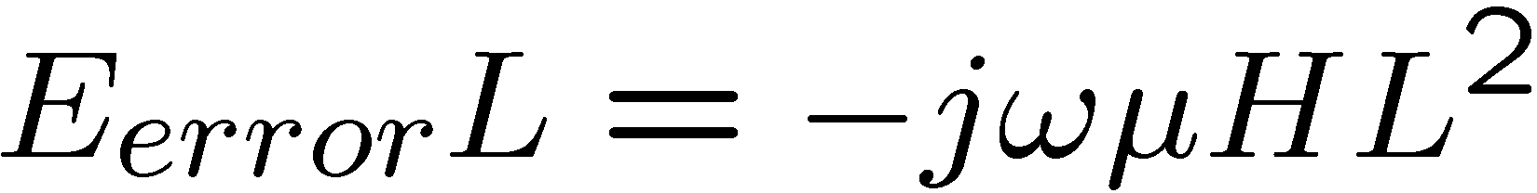
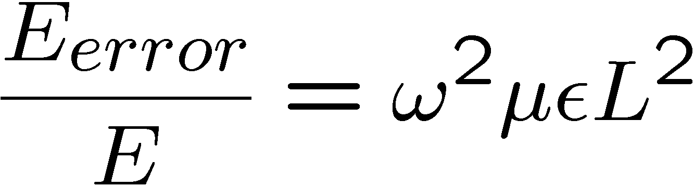
Characteristic Length and Time Scales
where

Slide 19
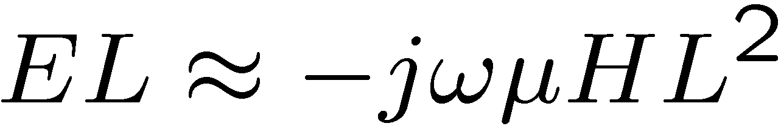
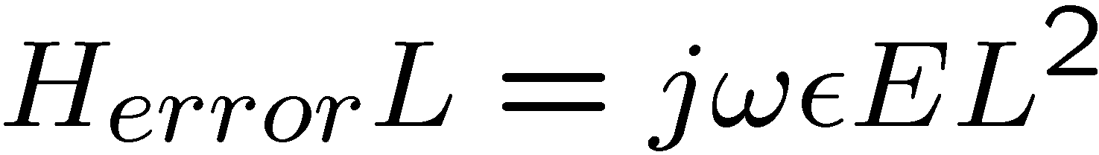
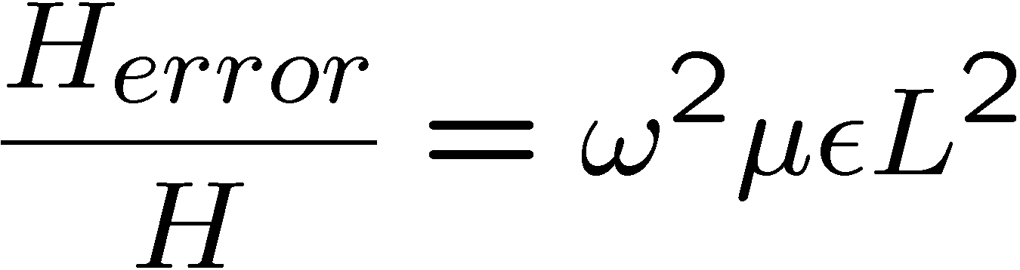
Characteristic Length and Time Scales
where

Slide 20
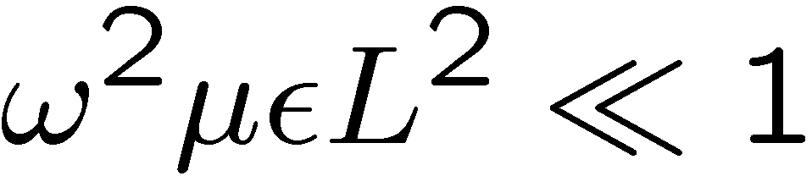
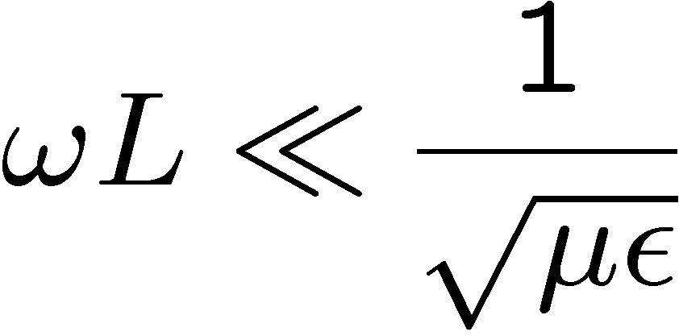
Error in Using the Quasi-static Approximation
For the error in using the QS approximation to be small we require …

Slide 21



EQS vs MQS for Time-Varying Fields
Why did we not worry about the magnetic field generated
by the time-varying electric field of a motor ?
for free-space
As another example, note:
At 60 Hz, the wavelength (typical length) in air is 5000 km, therefore, almost all physical
60-Hz systems in air are quasistatic (since they are typically smaller than 5000 km in size)

Slide 22
KEY TAKEAWAYS
Maxwell’s Equations couple H and E fields ...
For the error in using the Quasi-Static approximation to be small we require …
for free-space

Slide 23
EQS Limits
Approach:
J = σ E ; Del ~ 1/δ ;
∂/∂t ~ 1/T ; require small electric field correction
Ampere
Faraday
Small
Correction
and
… very fast magnetic diffusion
… very fast wave propagation

Slide 24
MQS Limits
Approach:
J = σ E ; Del ~ 1/δ ;
∂/∂t ~ 1/T ; require small magnetic field correction
Faraday
Ampere
Small correction
and
;
… very fast charge relaxation
Satisfied in small devices with high conductivity
… very fast wave propagation

Slide 25
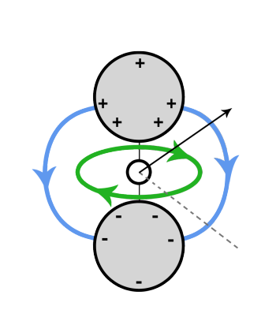
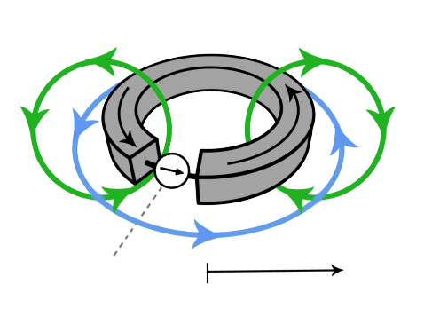
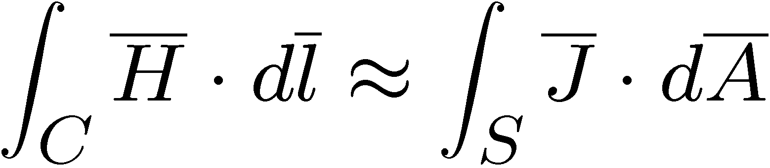
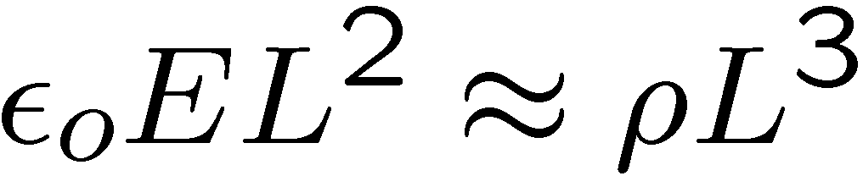
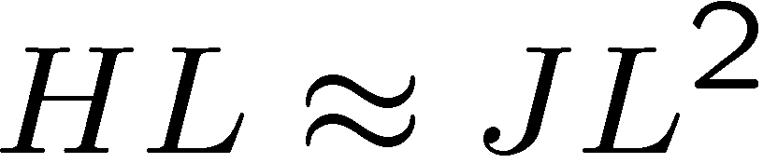
Characteristic Length and Time Scales
EQS Prototype System
H
MQS Prototype System
E
L
H
E
current
source
L
EMF source
Source of EMF drives a pair of perfectly conducting spheres having radius and spacing on the order of L
Current source drives perfectly conducting loop with radius of the loop and cross-section on the order of L

Slide 26
MIT OpenCourseWare
http://ocw.mit.edu
6.007 Electromagnetic Energy: From Motors to Lasers
Spring 2011
For information about citing these materials or our Terms of Use, visit: http://ocw.mit.edu/terms.

