Slide 1
Energy and Power
Outline
- First Law
- Heat and Friction
- Thru and Across Variables
- Energy Supply of Planet Earth
- Go-Cart
(platform for converting electrical to mechanical energy)

Slide 2
TRUE / FALSE
Heat is a form of energy, and has units of Joules.
Friction is the main source of heat loss for all mechanical systems.
Power is a measure of how much energy is delivered per unit time.

Slide 3
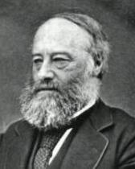
ENERGY: a very old and basic notion.
What is energy?
Energy is the ability to do useful work. It is the ability to move something, heat something, grind something, light something …
All other engineering disciplines study energy conversion
they just choose different energy inputs and outputs
(electrical, mechanical, chemical …)
James Joule (1818-1889)
SI unit of energy ~ Joule ~ [J]
1 J = 1 N m
Joules/seconds = Watts
Portrait in Public Domain
Notes:
Need more information than just “Wiki Commons”

Slide 4
One joule in everyday life is approximately:
the energy required to lift a small apple one meter straight up
the energy released when that same apple falls one meter to the ground
the amount of energy, as heat,
that a quiet person generates every hundredth of a second
the energy required to heat one gram of dry, cool air by 1 degree Celsius
one thousandth of the energy a person can receive
by drinking a 1mm diameter drop of juice
(Note: 1 food Calorie = 4184 Joules. 1 food Calorie is the amount of energy required to raise the temperature of one kilogram of water by one degree Celsius)
- the kinetic energy of an adult human
moving a distance of about a handspan every second.
How many calories do you need to eat per day?

Slide 5
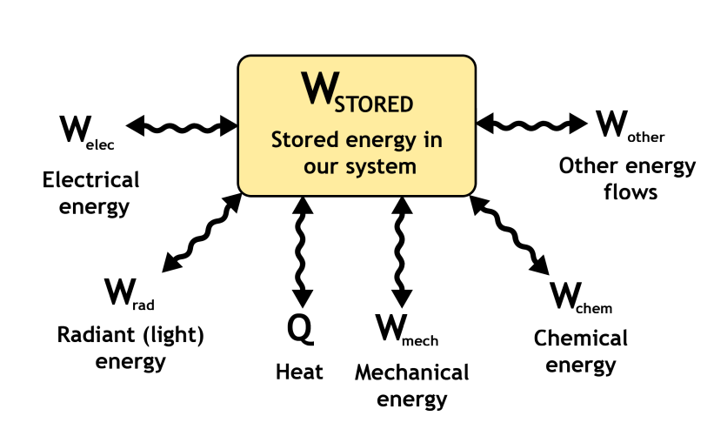
Let’s make a block diagram of a system
and consider energy flows in and out of the system:

Slide 6
The FIRST LAW of thermodynamics governs the behavior of
energy conversion systems. This “law” is not provable.
It is an accepted observation of how the universe always works.
Ignoring nuclear reactions, in which energy can be converted to mass
and vice-versa, the first law of thermodynamics says:
Energy is conserved
There are a number of equivalent ways to make this same statement. If the various energy flows W (electrical, mechanical, chemical, etc.) are all measured to be “positive” quantities when flowing OUT of the system (i.e., positive when the system is acting as a “source”) and Q is understood to be “positive” when flowing IN to the system (by thermodynamic convention), then the first law can also be written as:
This statement of the first law says that the energy stored in the system is equal to the difference between the heat flowing IN to the system and the sum of all of the other energy flows OUT of the system.

Slide 7
Another way to describe the first law is by considering a “closed cycle” of operation of the system. The definition of a closed cycle of operation is a sequence or pattern of system behaviors that start and end at the same system state. That is, over a closed cycle of operation, the change in stored energy is zero. In this case, we can express the first law this way:
That is, the sum of all of the infinitesimal flows of heat energy into a system over a closed cycle of operation must be offset by an equivalent sum of infinitesimal work flows out of the system over the cycle in order for the net change in stored energy to be zero.
0
if and only if

Slide 8
Why do we make a special symbol, Q, to distinguish heat energy flow from the other types of energy that could flow into or out of the system?
Heat is a special energy flow
All of the other types of flow are flows of energy, e.g., measured in joules.
Heat flow, which also can be measured in joules, affects the universe in a special way. It increases the vibrational energy of the materials in which it flows. Extra vibrational energy in atoms leads to “randomness” or disorder in the material structure. This disorder is called “entropy”. Generation or flow of heat is unique in that it increases entropy. Heat flow always increases entropy when real (lossy, with friction, resistance, etc.) systems are involved.
The entropy of a lump of material may apparently be lowered, e.g., by cooling the material. This apparent reduction in entropy always occurs at the expense of a greater increase in entropy somewhere else. That is, your refrigerator may cool your bubbly beverage, lowering the entropy of the drink. However, the entropy of your kitchen, where the heat from the beverage is transferred by the refrigerator, will increase more than the reduction of entropy in the beverage.

Slide 9
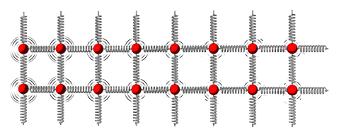
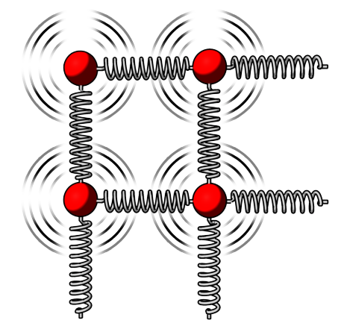
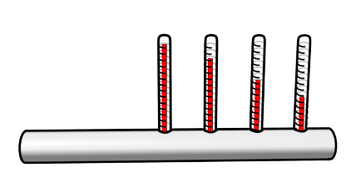
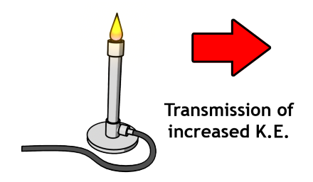
A Quick Word About Heat
Temperature is a measure of random kinetic energy

Slide 10
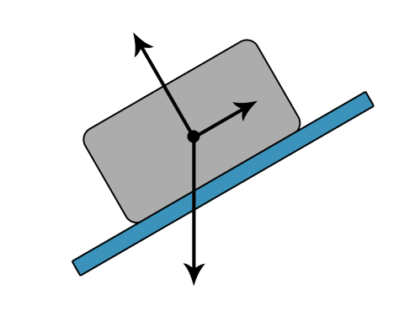
Atomic Origin of Friction
Why does friction depend
on the normal force ?
At the microscopic level even the smoothest of surfaces is dotted with little
“mountain peaks”
The tips of the peaks are the only parts that touch the
other material
Only a very small portion of the apparent surface area is in contact with the other surface
This causes extremely high pressures to form on the parts that touch. This causes the two surfaces to become “welded” almost at the points of contact
Even a smooth material like mica is not smooth in close-up!

Slide 11
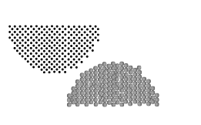
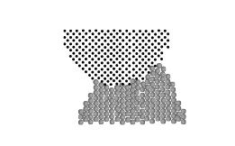
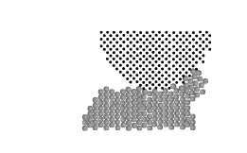
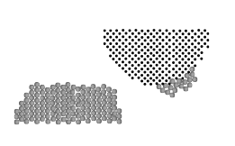
Atomic Origin of Friction
The true surface contact area is proportional to the normal force because the peaks will deform plastically when force is applied increasing the contact area
  - Plastic deformation: to change shape permanently without fracturing
(a)
(b)
(c)
(d)
Other lesser reasons for friction
- Surface adhesion between pure metals
- Ploughing of one surface by the other harder one
- Elastic deformation
Notes:
How many

Slide 12
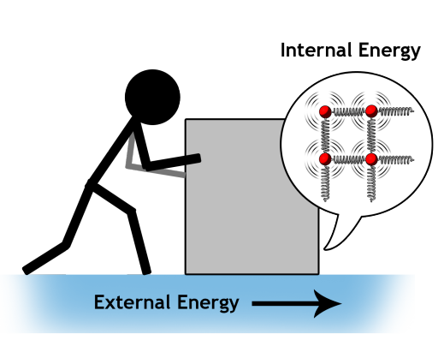
Atomic Origin of Friction
Notes:
The friction image is copyrighted!

Slide 13
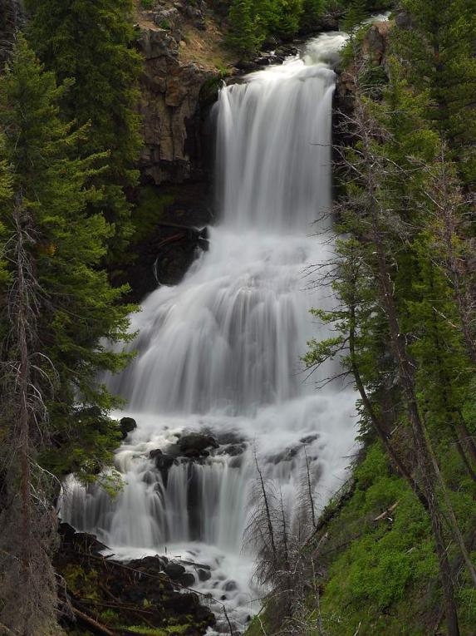

Today’s Culture Moment
James Prescott Joule was an English physicist and brewer, born in Salford, Lancashire. Joule studied the nature of heat, and discovered its relationship to mechanical work. This led to the theory of conservation of energy, which led to the development of the first law of thermodynamics. The SI derived unit of energy, the joule, is named after him. He worked with William Thomson (later Lord Kelvin) to develop the absolute scale of temperature.
From Wikipedia article on James Prescott Joule.
(Joule noted that a waterfall is
an energy conversion system
that allows us to quantify energy)
Joule (1818-1889)
All images in Public Domain

Slide 14
The SECOND LAW of thermodynamics states that
a net increase in the entropy of the universe
always accompanies heat flow in practical systems
As with the first law, there are a number of different ways to state the second law.
A practical consequence of the second law is that any practical machine that converts energy from one form to another, e.g., a motor that converts electrical energy to mechanical energy, will have an efficiency of conversion less than unity. That is, the efficiency or the ratio of mechanical power OUT divided by electrical power IN will be less than one. Any heat flow generated by inevitable real world loss mechanisms like friction and resistance will lead to unrecoverable energy losses during the conversion process.
Because heat flow is also associated with changes in entropy, it receives a special symbol, Q. Some energy conversion systems, like a refrigerator or a steam engine, are designed to make use of or to affect heat flows in their conversion process.

Slide 15
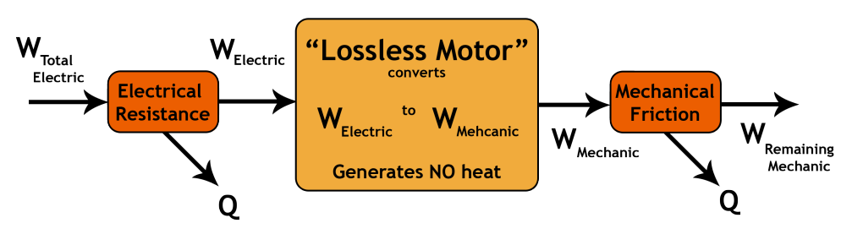
Other practical systems, like electric motors or generators, inevitably generate some heat, but only as an unfortunate, inevitable consequence of losses in the conversion process. For this second class of systems, we will often choose to mentally “move” the heat generating loss mechanisms out of the “box” that describes the system, so that we can focus on the pure conversion from one non-heat energy flow (e.g., electrical energy from a battery) to another non-heat energy flow (e.g., mechanical speed of a motor shaft).
For example, we might model a motor this way:

Slide 16
If we consider the total system, we have to account for the heat transfers in applying the first law. That is, we need an equation with W’s and Q’s.
If we focus on the “lossless motor”, then we can look at equations that just involve W’s. Of course, we have to be careful to focus on the “right” W’s, the energy flows that occur after we “pay” for the resistive losses and “before” we pay for the friction losses. Done carefully, this focus on the lossless motor will let us study the “pure” conversion process from one domain (electrical) to another (mechanical). In a practical system, we must remember that, after studying the lossless system, the losses must also be accounted.

Slide 17

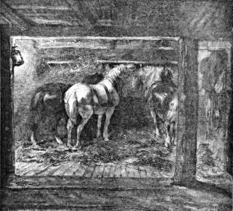
POWER is the rate at which energy is delivered
The same job accomplished more quickly
implies a higher power applied to the job
A typical farm horse, for example, can pull harder and make a heavy stone block move at a higher velocity than a typical person.
→ The horse is more powerful than the person.
James Watt studied energy conversion by observing the work of a horse (mine pony) in lifting coal out of a coal mine. He found that, on the average, a mine pony could pull (lift by means of a pulley) 22,000 foot-pounds per minute. Rather than call this "pony" power, he increased these test results by 50 percent, and called it horsepower (hp) i.e. 33,000 foot-pounds of work per minute.
James Watt
(1736-1819)
All images in Public Domain
1 hp = 746 Watts (units used in Watt’s honor)
Aside:
R. D. Stevenson and R. J. Wasserzug published an article in Nature 364, 195-195 (15 July 1993) calculating the upper limit to an animal's power output. The peak power over a few seconds has been measured to be as high as 14.9 hp. However, for longer periods an average horse produces less than one horsepower. - Wikipedia
horse stable inside a mine
From Wikipedia article on horsepower.

Slide 18
Across and Through Variables
The ports of many energy conversion systems are conveniently described by a set of “through” and “across” measurements or variables. The different types of “through”
and “across variables” distinguish different types of engineers
(electrical, mechanical, chemical, etc.). The first and second laws apply to everyone.
“ACROSS” variables typically measure how hard we are “pushing”.
Typical “across” variables include:
Force, from mechanical engineering, measured in Newtons (N = kg*m/(s*s))
Voltage, from electrical engineering, measured in volts (V)
Torque, or twisting force, from mechanical engineering, measured in N-m
Pressure, from ocean/aero engineering, measured in N/(m*m)
Associated “THROUGH” variables typically measure how much “stuff” is flowing:
Velocity, from mechanical engineering, measured in meters/sec (m/s)
Current, from electrical engineering, measured in Coulombs/sec or Amps
Angular Velocity, from mechanical engineering, measured in rads/sec
Flow, from ocean/aero engineering, measured in volume/sec or m*m*m/s

Slide 19
Power is a very old and basic concept
for any moving, living being on the earth.
Power is the product of an “across” variable and a “through” variable.
In more colloquial terms, it is a composite metric or product of
“how hard we’re pushing” (the across variable) and
“how much is flowing in response to the pushing” (the through variable).
FOR EXAMPLE:
- Mechanical power is force times velocity.
- Electrical power is voltage times current.
Power, whether electrical, mechanical, or in some other discipline,
is measured in units of Watts in the SI/MKS system.
How many Joules are in one kW hour ?

Slide 20
U.S. Energy Use
Coal
  We have lots of it.
  Twice as much CO₂ per kW-h as Gas,
  50% more than oil; can only rely on it if sequestration is practical and stable.
Gas
  Candidate “transition” fuel,
  but will have same supply issues as oil (just delayed).
Nuclear
  Challenges in disposal, proliferation
Notes:
Are you sure this is from Bulovic? It’s looks like data and needs to be redrawn.

Slide 21
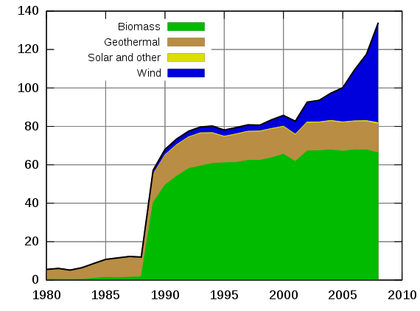
Non-Hydro Renewable Electricity Generation in the USA (TWh)
WIND
SOLAR &
OTHER
GEOTHERMAL
BIOMASS
WIND IS THE FASTES GROWING RENEWABLE TECHNOLOGY
Notes:
Please match fonts when doing redraw.

Slide 22
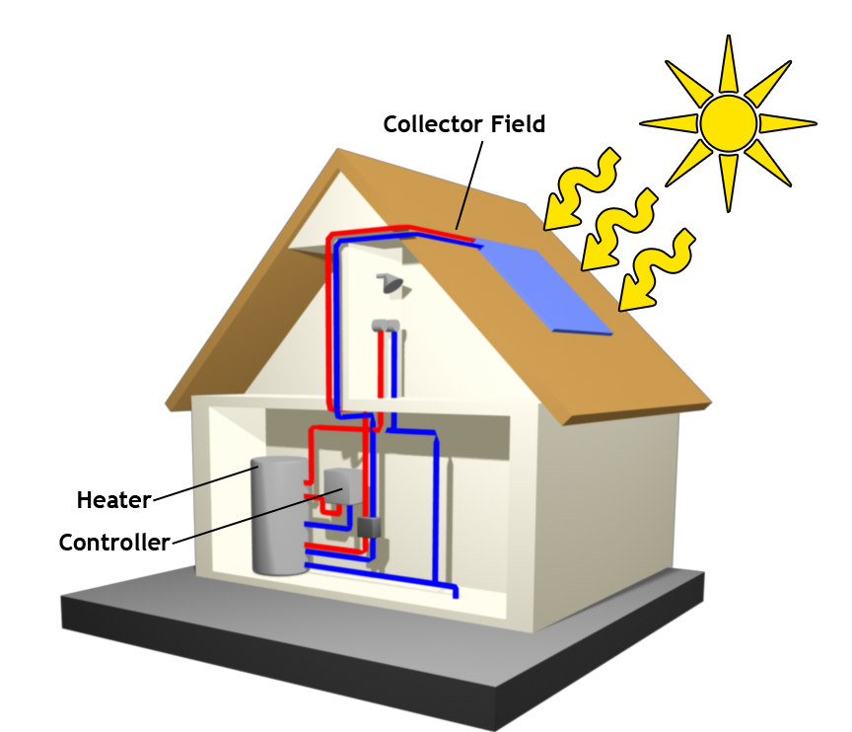
Solar Water Heating System
store &
heat exchangers

Slide 23
USA has not widely adopted Solar Water Heating
Total capacity of glazed flat-plate and evacuated tube collectors in operation at the end of 2006
Total capacity per 1,000 inhabitants [kW_{th}]
Total = 149 GW_{th}h
Source REN21 – “Renewables 2010 Global Status Report”
USA
Source: Weiss et al., “Solar Heat Worldwide”

Slide 24
Global Total = 21 GW
Source REN21 – “Renewables 2010 Global Status Report”

Slide 25
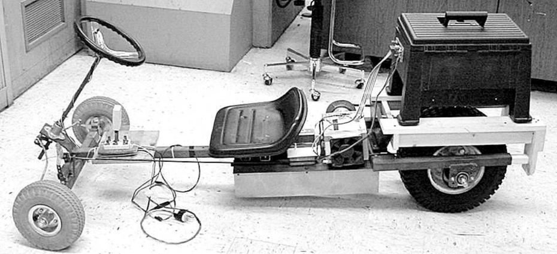
Here’s an energy conversion system:
AN ELECTRIC GO-CART
(converts the electrical energy of the battery into mechanical motion)
FORWARD
NEUTRAL
REVERSE
BATTERY
ELECTRICAL MOTOR
Go-cart designed and built by Prof. Steven B. Leeb,
To begin to understand the value of liquid fuels
(and the origins of the energy crisis facing the world)
tomorrow we will make measurements and calculations on our go-cart.

Slide 26
TRUE / FALSE
Heat is a form of energy, and has units of Joules.
Friction is the main source of heat loss for all mechanical systems.
Power is a measure of how much energy is delivered per unit time.
T
depends
T

Slide 27
KEY TAKEAWAYS
The First Law of Thermodynamics is never violated
Heat is simply the vibration of atoms, with vibrations transferable to other surfaces
Friction originates from interaction of atoms on surfaces
The Second Law of Thermodynamics necessitates that any practical machine that converts energy from one form to another will have an efficiency of conversion that is less than unity (for example electrical motor).
Product of “Through” and “Across” variables is Power
1 kW-hr = 3.6 MJ
Solar energy is abundant, but seldom used due to the low energy density of the solar flux, that makes solar energy capture relatively expensive.
Well-being of an individual in a country increases with increased per-capita use of energy.

Slide 28
MIT OpenCourseWare
http://ocw.mit.edu
6.007 Electromagnetic Energy: From Motors to Lasers
Spring 2011
For information about citing these materials or our Terms of Use, visit: http://ocw.mit.edu/terms.

