Slide 1
From Atoms to Solids
Outline
- Atomic and Molecular Wavefunctions
Molecular Hydrogen
Benzene

Slide 2
A Simple Approximation for an Atom
Let’s represent the atom in space by its Coulomb potential centered on the proton (+e):
Continuum of free electron states
-e
+e
r
n = 3
n = 2
energy of -e
n = 1
Continuum of free electron states
Finite Quantum Well:

Slide 3
A Simple Approximation for a Molecule
Continuum of free electron states
If this were the ‘atomic’ potential,
Bound states
Continuum of free electron states
then this would be the ‘molecular’ potential:
We do not know exactly what the energy levels are,
although in 1-D we could solve the equation exactly if we had to
Notes:
3

Slide 4
‘Molecular’ Wavefunctions
“Atomic” Wavefunctions:
L = 1 nm
“Molecular” Wavefunctions: 2 ‘atomic’ states → 2 ‘molecular’ states
When the wells are far apart, ‘atomic’ functions don’t overlap.
A single electron can be in either well with equal probability, and E = 0.4 eV.
Notes:
4

Slide 5
‘Molecular’ Wavefunctions
d
L = 1 nm
WELLS FAR APART:
(“Degenerate” states)
WELLS CLOSER TOGETHER:
d
‘Atomic’ states are beginning to overlap and distort.
|Ψ_{even}|² and |Ψ_{odd}|² are not the same (note center point). Energies for these two states are not equal.
(The degeneracy is broken.)
Notes:
5

Slide 6
‘Molecular’ Wavefunctions
1. Which state has the lower energy?
d
(a) Ψ_{even}
(b) Ψ_{odd}
2. What will happen to the energy of Ψ_{even} as the two wells come together
(i.e., as d is reduced)?
(a) E increases
(b) E decreases
(c) E stays the same
Notes:
6

Slide 7
Bonding Between Atoms
How can two neutral objects bind together?
H + H → H₂
-e
+e
Continuum of free electron states
Let’s represent the atom in space by its Coulomb potential centered on the proton (+e):
r
n = 3
n = 2
energy of -e
n = 1
+e
+e
+e
Continuum of free electron states
-e
Superposition of Coulomb potentials H₂:
r
energy of -e

Slide 8
Molecular Hydrogen
σ antibonding molecular orbital
Energy
1s atom
orbital
1s atom
orbital
σ bonding
molecular orbital

Slide 9
Molecular Hydrogen Binding Energy
4.
3.
2.
1.
0
Energy
released
when bond
forms
(-Bond
Energy)
1.
-100
Energy
absorbed
when bond
breaks
(+Bond
Energy)
-200
Potential Energy [kJ/mol]
2.
-300
4.
-400
-432
3.
-500
74
100
200
(H₂ bond length)
Internuclear Distance [pm]

Slide 10
Tunneling Between Atoms in Solids
-e
+e
r
Again start with simple atomic state:
energy of -e
n = 1
Bring N atoms together together forming a 1-d crystal (a periodic lattice)…
-e
energy of -e

Slide 11
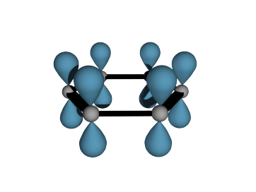
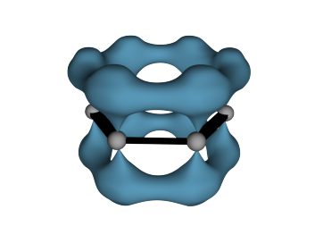
Let Take a Look at Molecular Orbitals of Benzene
… the simplest “conjugated alkene”
H
Typical C-C bond length 1.54 Å
Typical C=C bond length 1.33 Å
1.08 Å
H
C
H
C
C
or
1.395 Å
C
C
H
C
H
Length of benzene
carbon-carbon bonds is between
C-C and C=C bond lengths
H
p orbitals
π-electron density
© Source unknown. All rights reserved. This content is excluded from our Creative Commons license. For more information, see http://ocw.mit.edu/fairuse.

Slide 12
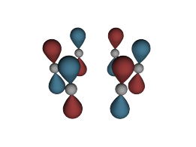
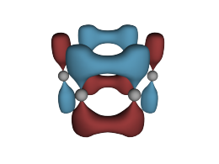
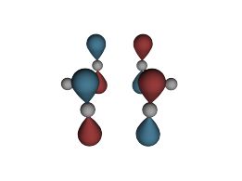
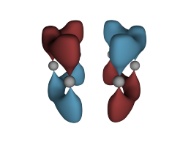
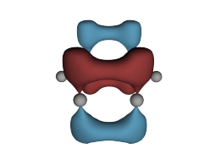
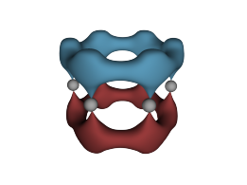
Molecular Orbitals of Benzene
ELECTRON ENERGY
ELECTRON ENERGY
Electron Energy
Energy distribution of
Benzene π-molecular orbitals
Carbon atoms are represented by dots
Nodal planes are represented by lines
© Source unknown. All rights reserved. This content is excluded from our Creative Commons license. For more information, see http://ocw.mit.edu/fairuse.
antibonding MOs
energy of isolated
p-orbital
Energy
bonding MOs
from Loudon

Slide 13
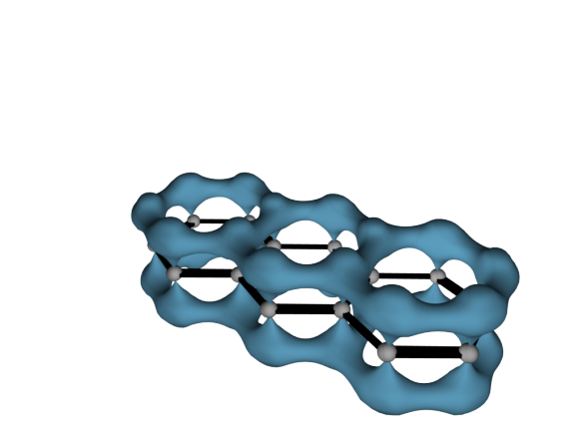
… More Examples – Series of Polyacene Molecules
The lowest bonding MO of anthracene
Benzene
Naphthaline
Anthracene
Tetracene
Pentacene
255 nm
315 nm
380 nm
480 nm
580 nm
© Source unknown. All rights reserved. This content is excluded from our Creative Commons license. For more information, see http://ocw.mit.edu/fairuse.
Red: bigger molecules !
Blue: smaller molecules !
20000
25000
30000
35000 cm⁻¹
Luminescence Spectra
ENERGY

Slide 14
Tunneling Between Atoms in Solids
Conduction in nanostructured materials
energy of -e
electron
atomic spacing
Conduction in nanostructured materials (with Voltage applied)
energy of -e
TUNNELING IS THE MECHANISM FOR CONDUCTION

Slide 15
Coulomb’s Law and Atomic Hydrogen
Let’s represent the atom in space by its Coulomb potential centered on the proton (+e):
Continuum of free electron states
-e
+e
r
n = 3
n = 2
energy of -e
n = 1
Time-Independent Schrödinger Equation

Slide 16
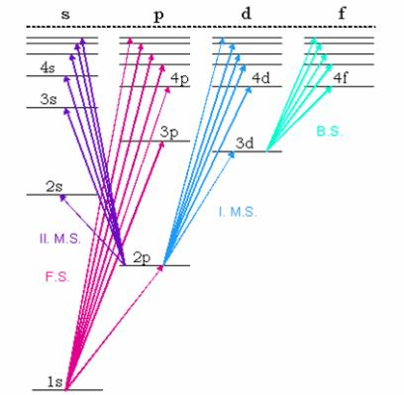
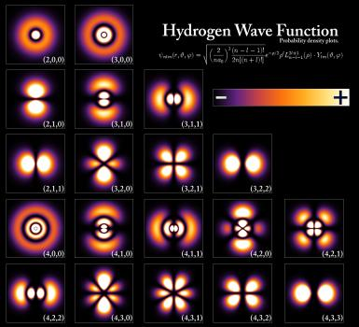
Solutions
Image in the Public Domain
Image by Szdori on Wikipedia.
a₀ = 0.0529 nm
I_{H} = 13.606 eV
These are some solutions,
without normalization.

Slide 17

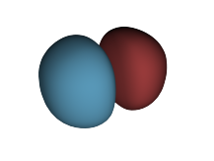
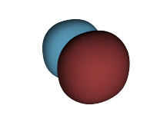
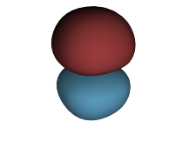
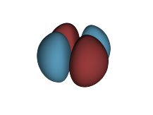
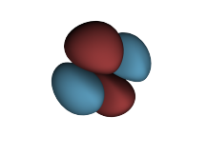
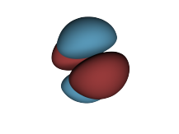
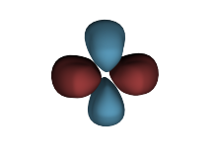
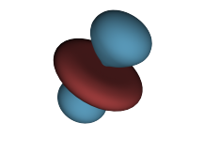
Solutions
BOUNDARY SURFACES OF
s, p, d atomic orbitals
s
p_{x}
p_{y}
p_{x}
d_{xy}
d_{xz}
d_{yz}
d_{x}²—_{y}²
dz²
© Source unknown. All rights reserved. This content is excluded from our Creative Commons license. For more information, see http://ocw.mit.edu/fairuse.

Slide 18
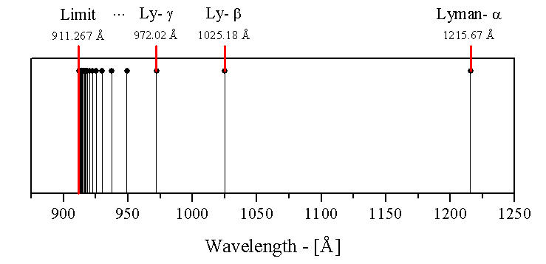

1s-np transitions in atomic hydrogen
Image in the Public Domain
The Lyman alpha blob, so called because of its Lyman alpha emission line, photons must be redshifted to be transmitted through the atmosphere
Image in the Public Domain

Slide 19

Energy Levels of Atomic Lithium
0
l=0
l=1
l=2
l=3
l=4
5s
5p
5d
5f
5g
n=5
-1
4s
4p
4d
4f
n=4
3p
3d
n=3
-2
3s
-3
Energy (eV)
Lithium energy
diagram
2p
n=2
-4
Hydrogen
levels
2s
Ground state
-5
Image in the Public Domain
Ground state is 1s²2s, excited states shown are 1s²np

Slide 20
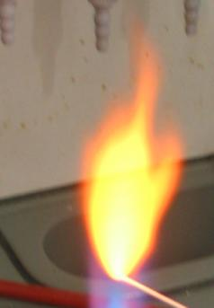
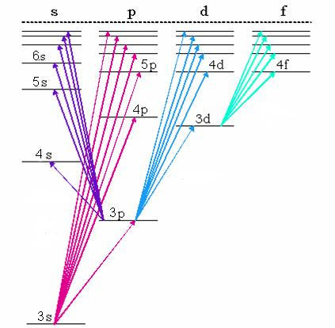
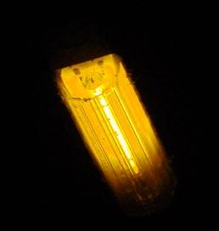
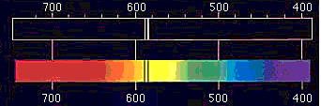
Energy Levels of Atomic Sodium
Image in the Public Domain
Image by Orci on Wikipedia.
Image in the Public Domain
Image in the Public Domain

Slide 21
Example: Barrier Tunneling
Let’s consider a tunneling problem:
  An electron with a total energy of E_{o}= 6 eV approaches a potential barrier with a height of
  V₀ = 12 eV. If the width of the barrier is
  L = 0.18 nm, what is the probability that the electron will tunnel through the barrier?
V₀
E_{o}
metal
metal
0
L
air
gap
x
Question: What will T be if we double the width of the gap?
Notes:
21
Answer: With twice the thickness, the exponential factor comes in twice. Therefore, T = 4(0.011)^2 =0.05%

Slide 22
Leaky Particles
Due to “barrier penetration”, the electron density of a metal
actually extends outside the surface of the metal !
x
V_{o}
Work
function Φ
E_{F}
Occupied levels
x = 0
  Assume that the work function (i.e., the energy difference between the most energetic conduction electrons and the potential barrier at the surface) of a certain metal is Φ = 5 eV. Estimate the distance x outside the surface of the metal at which the electron probability density drops to 1/1000 of that just inside the metal.
(Note: in previous slides the thickness of the potential barrier was defined as x = 2a)
using

Slide 23
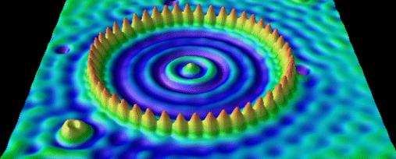
Application: Scanning Tunneling Microscopy
Vacuum
Second Metal
Piezoelectric Tube
With Electrodes
Tunneling
Current Amplifier
Tip
Sample
Tunneling
Voltage
Image originally created by IBM Corporation.
© IBM Corporation. All rights reserved. This content is excluded from our Creative Commons license. For more information, see http://ocw.mit.edu/fairuse.
Notes:
http://www.quantum-physics.polytechnique.fr/en/ -- wave mechanics – scanning tunneling microscope

Slide 24
MIT OpenCourseWare
http://ocw.mit.edu
6.007 Electromagnetic Energy: From Motors to Lasers
Spring 2011
For information about citing these materials or our Terms of Use, visit: http://ocw.mit.edu/terms.

